Slide 1
Compatible data processing for DHIS2 for AMR surveillance Integration in Rightbiotic platform
Athul V 2018B1A30860H

Slide 2
Aim of the project
This project is to integrate AMR Data surveillance of Right Biotic Platform with DHIS2.
The machine is used to determine the sensitivity of bacteria towards various antibiotics.
DHIS2 can be used to centralise the existing platform, so it can be used by various people from around the world and help in the analysis of the data

Slide 3
What are Antimicrobials
They are Medicines used to treat infections caused by microbes in humans, animals, and plants. They include antibiotics, antiparasitics, and antifungals.

Slide 4
What is AMR ? Antimicrobial Resistance?
When Bacteria, Fungi, Viruses mutate over time and and no longer respond to medicines i.e they become resistant to antimicrobials.
Increasing the risk of disease spread, severe illnesses, and death.
And microbes being impossible to treat.
This is caused by over use of antimicrobials in humans, animals and plants

Slide 5
Antimicrobial Resistance a global concern and why do we need to survey it.
The emergence of drug-resistant microbes have acquired new resistance mechanisms. These so-called superbugs that are resistant to multiple drugs and are spreading at an alarming rate.
In 2019 WHO identified 32 new drugs to combat their top priority diseases and only six out of them were classified as innovative or new.

Slide 6
What the future holds...
If people don't change the way they use antibacterial and antiviral drugs are used now. The newly formed antibiotics will reach the same fate as the current ones and become ineffective.

Slide 7
Without tools, for the prevention and treatment of drug-resistant infections, it can soon become a global crisis.

Slide 8
Our Solution - The Rightbiotic

Slide 9
The RightBiotic Machine
The machine called the RightBiotic, analyzes samples inserted into it (urine samples)and gives out a result of the bacterial load, the type of bacteria and the sensitivity to the panel of antibiotics used.

Slide 10
The Right Biotic Machine
The machine comes with hardware for taking readings from different samples.
The growth of these bacteria is monitored by calorimetry.
The data obtained is analyzed for reporting the sensitivity to the panel of antibiotics used.
The results obtained are stored in the form of CSV files.

Slide 11
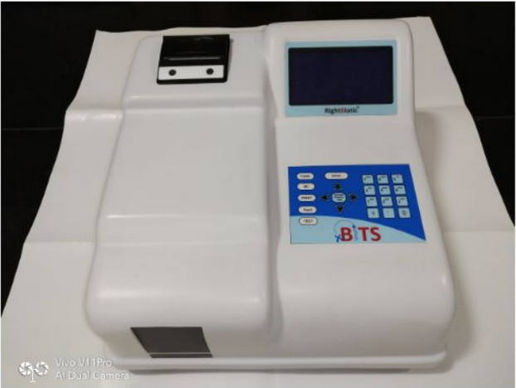
Thermal Printer
That prints the CSV file
Display
Numpad
Lan port for transferring data

Slide 12
result of the bacterial load,
sensitivity to the panel of antibiotic used.
simple Resistant, Sensitive and Intermediate Tag
calorimetry and nephelometry.
Urine Sample

Slide 13
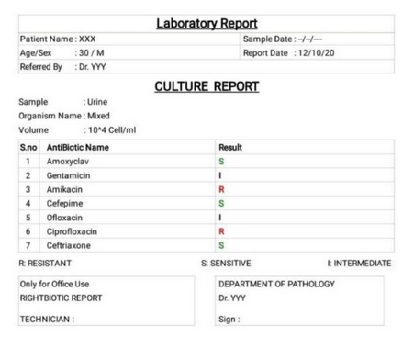
Sensitive
Resistant
Intermediate
The current pdf generated is shown below. It shows Resistance, Sensitive and Intermediate as Lab Results for Antibiotic Name.

Slide 14
Why does the machine matter ?
Usually the time taken by a lab to obtain the results is about 3-4 days,
But this machine has been able to significantly reduce the time to about 4-5 hours.
Pathogens to mutate, antibiotics that work today may or may not work six months from now.
Hence, sensitivity tests are extremely important and useful tools. The
machines will hence play a significant role in improving the field.

Slide 15
The Current App
The current app has the following affordances:
a) Start an internal server:
b) Retrieve and process files: It can receive files over the network and then extract the data from them and process it into a labelled file.
d) It can be used to open the internal storage where the files are stored with their dates.
f) The files received can also be viewed in the app in a scroll view for easy access.
g) The pdf files received and shown on the app are clickable and the filename is the patient id.

Slide 16
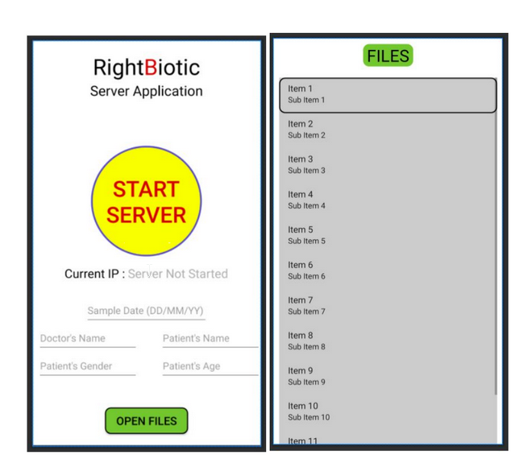
Starts the server
Shows the current IP
Data shown
After search
Search based
On Sample Date etc

Slide 17
DHIS2
DHIS2 is an application that helps in a) Collect Data b)Process data and turns it into indicators.
c) Stores and protects the data and helps in analysis of information in various Ways
d)Presents information in reports and dashboard
e)Shares information with other systems, e.g, surveillance and tracking

Slide 18
DHIS2 can help in Collection of our data and processing of the data.

Slide 19
Comparison table of different platforms available.
Name | Pros | Con
1.OpenEMR | Electronic Medical Records,fully integrated electronic medical records, practice management for a medical practice, scheduling, and electronic billing | Mostly used for medical purposes and places like hospitals rather than onsite small clinics.
2.OpenMRS: | General-purpose electronic medical record system that could support the full range of medical treatments. | Used for medical treatment logs, our aim was more inclined towards AMR Surveillance
3.Dhis | It is stable and well supported. Its features full. They release a new version every three months It is resilient, flexible, decentralized. | None mentionable. The program is complex and large for new users to work with.

Slide 20
Reasons for choosing DHIS2
DHIS2 is an open-source program that was developed 20 years ago
ago. It is stable and well supported.
They release a new version every three months. It is resilient, flexible,
Decentralized.
It has already been tried and tested for AMR surveillance by HISP India.

Slide 21
Sensitive
Resistant
Intermediate
The current pdf generated is shown below. It shows Resistance, Sensitive and Intermediate as Lab Results for Antibiotic Name.

Slide 22
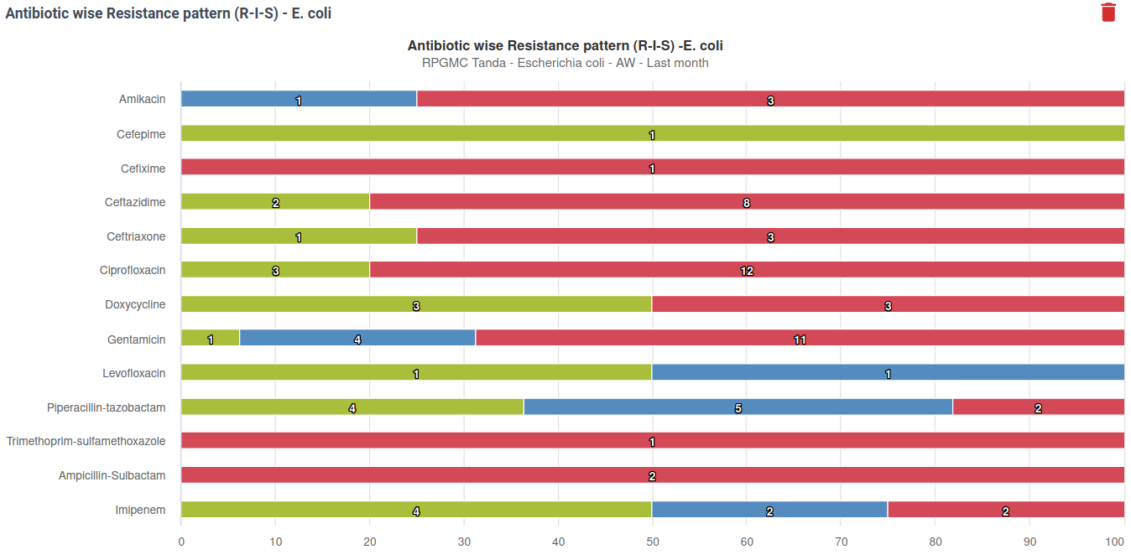

Slide 23
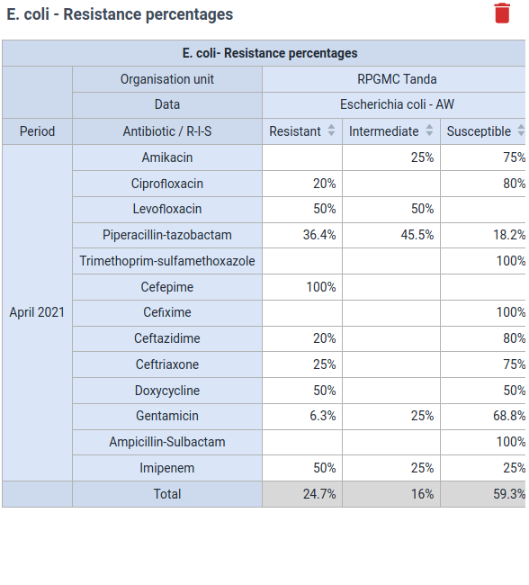

Slide 24
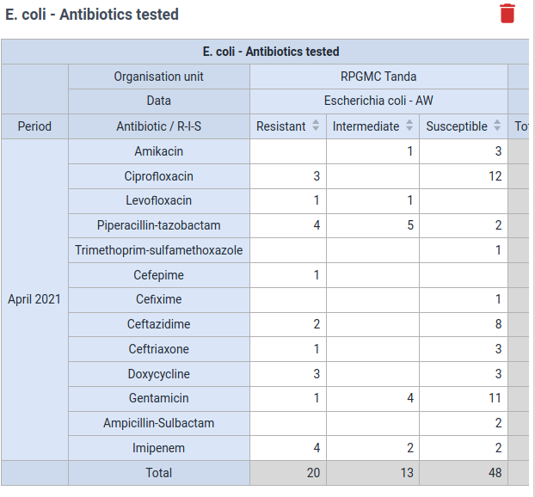

Slide 25
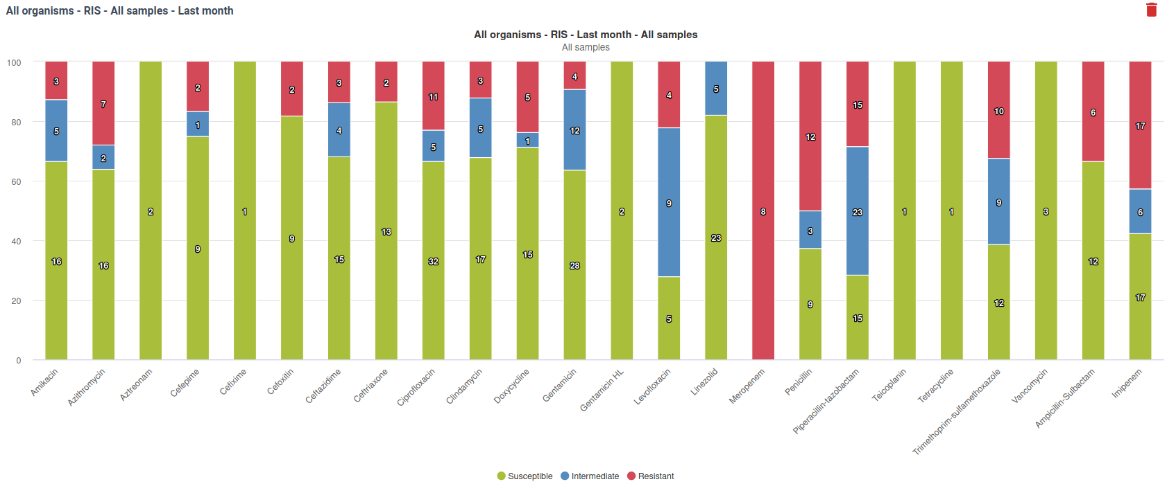

Slide 26
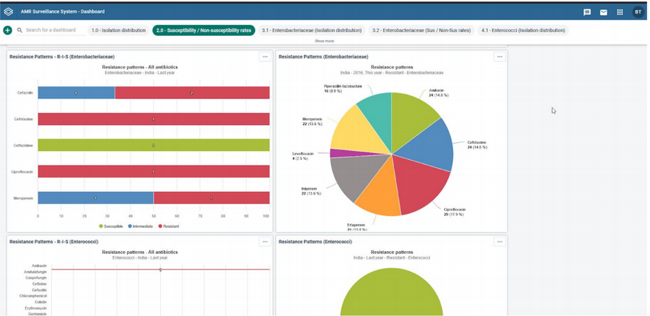

Slide 27
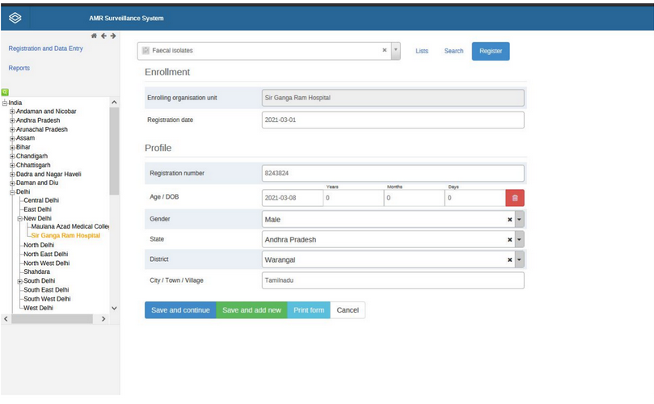

Slide 28
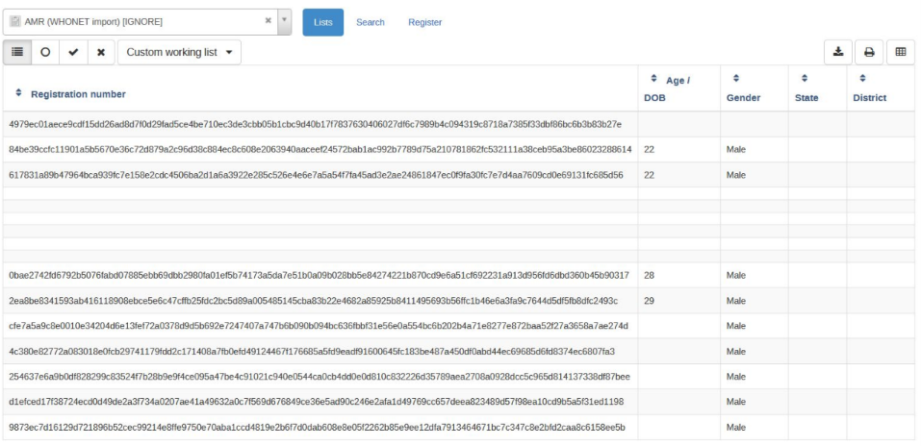

Slide 29
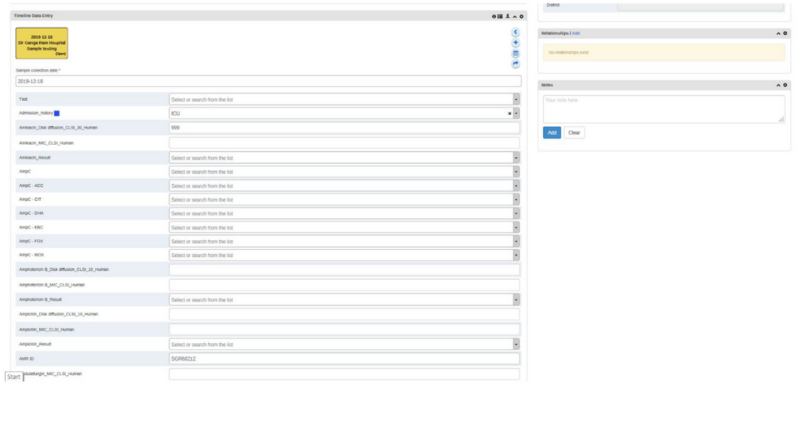

Slide 30
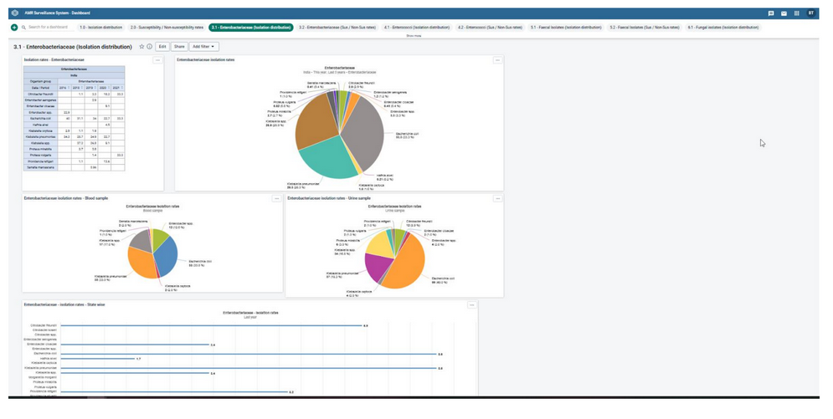

Slide 31
DHIS2 Extension to the Existing App
This project is to integrate AMR Data surveillance of Right Biotic Platform with DHIS2.The machine is used to determine the sensitivity of bacteria towards various antibodies.DHIS2 can be used to centralise the existing platform, so it can be used by various people from around the world.
The update to integration can be done using WebAPI provided by the DHIS2 Platform. The Web API is a component which makes it possible for external systems to access and manipulate data stored in an instance of DHIS2. We can use Web API to grant access to the current existing app to create and modify server data.

Slide 32
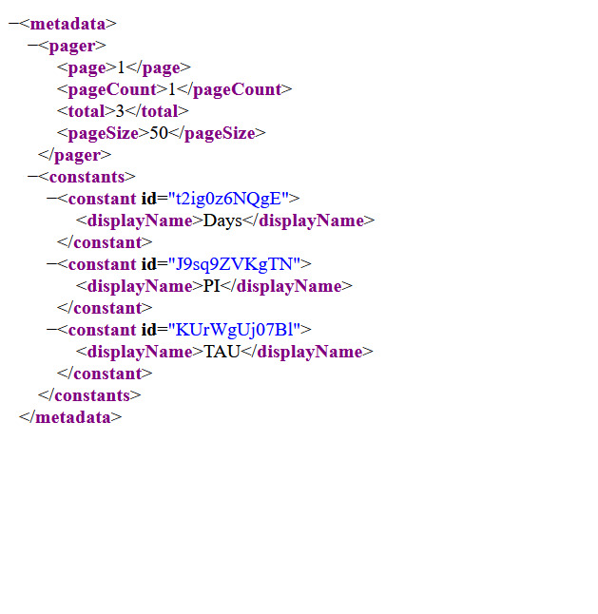
DHIS2 - Web API
We have set up a web api for the server of DHIS2.
A web api is Application Programming Interface for the web server.
It has one or more publicly exposed endpoints to a defined request–response message system.
This response can be a POST or GET.

Slide 33
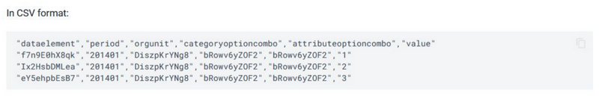
Currently DHIS2 supports CSV, Json and XML POST command.
As the app uses CSV, we can directly POST it to the server.

Slide 34
Using Retrofit 2.x as a REST client
Retrofit is a REST API client for Andriod. It is relatively easy to retrieve and upload CSV and JSON files. Retrofit turns your HTTP API into a Java interface.

Slide 35
Conclusion and Future Work
The newly integrated app helps in tightly integrating DHIS2 and RightBiotic App. It uses the web API interface of DHIS2 and Retrofit library for Andriod to post and get data from the main database servers.
Some improvements that DHIS2 brings to the app is that
It introduces a search engine for searching that can be referenced through patient id.
It provides an upgrade to the cloud-based system where all the users have access to the data.
It provides an analysis of past trends and patterns.

Slide 36
Acknowledgement
I would like to express my gratitude towards BITS Hyderabad and Dr. Suman Kapur for
providing me with the opportunity to work on this project and make a difference in the
medical field and understand the technical needs of the same. I would like to thank Gitika
Arora and the team of HISP India for providing me with guidance on the DHIS2 platform
and framework.
For More information and help , please contact - Gitika Arora <gitika.arora@hispindia.org>
Sourabh Bhardwaj <sourabh.bhardwaj@hispindia.org>

Slide 37
THANK YOU
STAY SAFE

